Slide 1
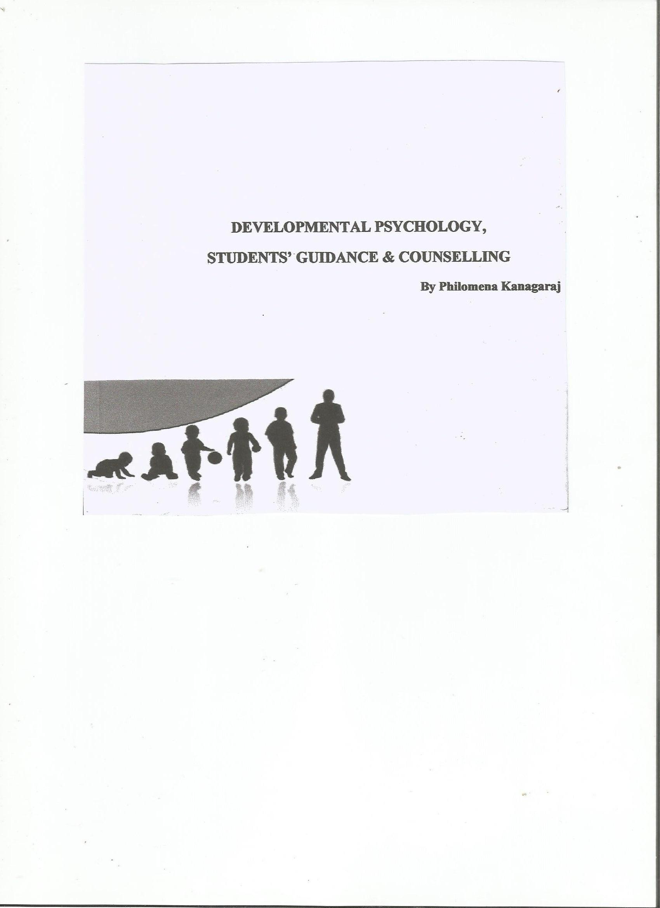
DEVELOPMENTAL PSYCHOLOGY, STUDENTS’ GUIDANCE & COUNSELLING by Philomena Kanagaraj

Slide 2
Children
But Jesus said ‘Suffer little children, and forbid them not, to come unto me, for of such is the kingdom of heaven’. Matt 19 :14 (King James version)
But Jesus said, “Let the little children come to me, and don’t prevent them. For of such is the Kingdom of Heaven.” Matt 19:14 (Lindsell Study bible)

Slide 3
PSYCHOLOGY & Child Psychology
Psychology : Two Greek words ‘Psyche’ meaning soul and ‘logus’ meaning science or knowledge; Is the Science of the soul.
Today Psychology is the Science of Behaviour
Child Psychology : ‘The branch of psychology which deals with growth and development of children, role of heredity and environment in child development, different potentials found in children and their measurement, different aspects of adjustment in behaviour with environment that children achieve etc., is known as Child Psychology.
Definition of psychology : “a science that systematically studies and attempts to explain observable behaviour and its relationship to unseen ‘mental’ processes (experiences) that go on inside the organism and to external events in the environment.”
Notes:
Prof. K. Nagarajan, Psychology of Learning and Human Development.

Slide 5
STAGES OF SOCIAL DEVELOPMENT E.H. ERIKSON
S.No | Stage | Basic Conflict | Important Events | Outcome
1. | Infancy (birth to 2 years) | Trust Vs. Mistrust | Feeding | Children develop a sense of trust when caregivers provide reliability, care, and affection. A lack of this will lead to mistrust.
2. | Early Childhood (2 to 3 years) | Autonomy Vs. Shame and Doubt | Toilet Training | Children need to develop a personal control over physical skills and a sense of independence. Success leads to feelings of autonomy, failure results in feeling of shame and doubt.
3. | Pre School (3 to 5 years) | Initiative Vs. Guilt | Exploration | Children need to begin asserting control and power over the environment. Success in this stage leads to a sense of purpose. Children who try to exert too much power experience disapproval, resulting in a sense of guilt.
4. | School Age (6 to 12 years or puberty) | Industry Vs. Inferiority | School | Children need to cope with new social and academic demands. Success leads to a sense of competence, while failure results in feelings of inferiority.

Slide 6
STAGES OF SOCIAL DEVELOPMENT … p/2
S.No | Stage | Basic Conflict | Important Events | Outcome
5. | Adolescence (13 to 19 years) | Identity Vs. Confusion | Social Relationships | Teens need to develop a sense of self and personal identity. Success leads to an ability to stay true to yourself, while failure leads to role confusion and a weak sense of self.
6. | Young Adulthood(19 to 40 years) | Intimacy Vs. Isolation | Relationships | Young adults need to form intimate loving relationships with other people. Success leads to strong relationships, while failure results in loneliness and isolation.
7. | Middle Adulthood (40 to 65 years) | Generativity Vs. Stagnation | Work and Parenthood | Adults need to create or nurture things that will outlast them, often by having children or creating a positive change that benefits other people. Success leads to feelings of usefulness and accomplishment, while failure results in shall involvement in the world.
8. | Maturity (65 to death) | Ego Integrity Vs. Despair | Reflection on Life | Older adults need to look back on life and feel a sense of fulfillment. Success at this stage leads to feelings of wisdom, while failure results in regret, bitterness and despair.

Slide 7
3.0 ADOLESCENCE
Adolescence
is a ‘Transitional Period’. Children must put away childish things and they must also learn new patterns of behavior and attitudes.
Is a ‘Problem Age. They cannot act either as a child or an adult.
is a ‘Time of Search for Identity,’ crave for identity and not satisfied to be like their peers .
Is a ‘time of unrealism’ develop unrealistic aspirations.
5 Is the ‘Period of Storm and Stress’ – a time of heightened emotional tension.

Slide 8
3.0 ADOLESCENCE (cont’d…p/2)
Adjustment difficulties with School Discipline : restrictions on adolescents by some Schools – should not talk to opposite sex, have a haircut.
Financial Problem : pocket money not sufficient. Sometimes they steal parents’ money.
Conflicts between Parents’ Aspiration and that of the Children. Due to the conflict some of them go away from home and some commit suicide.
Problems related to physical appearance : adolescents with the underdeveloped or overdeveloped physique, handicaps, diseases etc. develop various complexes and they feel isolated from the group.
Heterosexual Adjustment problems : parents and teachers put
restrictions on the youngsters to have friendship with opposite sex, they want to mingle with them. These unsolved motives get aggravated and negative activities follow.

Slide 9
3.2 DEVELOPMENTAL PROBLEMS OF ADOLESCENTS IN INDIA
Physical changes : lack of scientific knowledge about sex hygiene and physiology leads to guilty feeling and many other complexities among adolescents.
Inquisitive Sex : some adolescents resort to socially unacceptable ways to satisfy their curiosity about sex-related matters as parents are mostly shy about revealing or discussing with their children. Media pornography is another way they learn about sex.
Transitional Conflict : neither a child or an adult. Independent views and opinions like an adult. Sometimes he is treated as a child sometimes as an adult by the parents. This leads to conflict in mind about his status.
Adjustment problems with Parents : Adolescents want to be independent, in their choices and selections viz. friends, dress, recreational interests, study
5 Adjustment difficulties with Community : want to enjoy with peers. They have to make up their mind whether to stay with peers or go with the goal in life.
Yakaiah, Psychology of Childhood and Adolescence, pg 10 & 11

Slide 10
3.2 Developmental problems in adolscents … p/2
A hero-worshipper
Sex-consciousness becomes too intense – they get interested in the opposite sex.
Peer group relationship is too intense – they are following the group norms
Is a ‘Period of Day-Dreaming.’ Exuberant imagination.
Is the period of acquiring the attitudes and values which are essential for the effective participation in society.
Is a period where ‘falling in love’ is prevalent, even sometimes with the Teacher or Master.

Slide 11
3.3 Frustrations
‘Frustration refers to failure to satisfy a basic need because of either conditions in the individual or external obstacles’. Barney and Lehner.

Slide 12
Causes for Problem behaviour in children
‘PROBLEM CHILD’, ‘PROBLEM BEHAVIOUR’
The anti-social behaviour of some children is called ‘problem behaviour’ and such children are called ‘problem child’.
Common behavioural problems are truancy, lying, bullying, stealing, destruction of common property, adolescent sexual misbehaviour, disobedience to those in authority, picking up quarrels for flimsy reasons, loud & boisterous, shouting, creating scenes in public places, frequently indulging in mischief etc.
Physical conditions
Psychological Factors
Broken Home
Attitude of Parents
Socio-Economic Conditions
School Environment

Slide 13
3.4 COMMON TYPES OF DEFENCE MECHANISMS
1 Introversion : Maladjusted behaviour of withdrawing oneself totally from the social world and remaining aloof. (Sam 20 yrs old) Severe introversion may lead to antisocial behaviour.
2 Fantasy : Day-dreaming or fantasy, mind wanders aimlessly among pleasant imagery, gratifying wishes and desires that are ungratified in real life. This dream world is limited by the individual’s imagination. He achieves in his world of fantasy, what he could not achieve in real life.
Continued fantasy, results in the disorganization of the individual personality.
3 Projection : Students are the victims of their parents’ projection of their hopes of higher education and thereby better life. (Ms Sophie) tendency to force on another person, one’s own unrealized frustrated ambitions.
In the mental disorder known as paranoia, the mechanism of projection is used to an extreme degree.
4 Rationalisation When a plausible reason or excuse is given, instead of the real reason. It is more often self-deception and not lying to deceive others. E.g. Fox and the Grapes ‘Grapes are sour’.

Slide 14
3.4 Common types of defence mechanisms
5 CompensationIt is a form of behavior of an individual, when he/she makes an attempt to overcome weakness or limitations by drawing attention to his/her strong or favourable characteristic. For e.g. a student backward in studies may try to shine in sports or extra curricular activities.
6 Identification : The process of enhancing one’s self-worth by identifying themselves with an illustrious person or institution is called identification. For e.g. Basking in the shadow of the Head of the Company, Organisation.
7 Regression : the individual retreats to or adapts infantile or primitive forms of behavior. Throwing trantrums, creating a scene, threatening to leave home, refusing to speak, are common childish (regressive) devices used by adults.
Extreme form of regressive behavior is typical in some mental disorders such as Schizophrenia. Thus manifesting child behavior of unwillingness to eat, bathe or dress himself or herself.
8 Displacement : A particular motive or emotion (or frustration) is turned to another unsuspecting object, totally unconnected. For e.g. boss shouts at man; man shouts at wife; wife shouts at child; child kicks the dog; dog bites a passerby and so on and so forth.

Slide 15
3.4 Common types of Defense Mechanisms
Sublimation : when a person’s urges or impulses could not be gratified and to assuage the frustration, he might engage himself in substitute activities , which are socially valued and acceptable.
Allport says, ‘Sublimation is a device by which antisocial impulses are made
socially acceptable’.
Withdrawal : Withdrawing from a situation that causes frustration or failure – makes himself by running away from the difficult scene.
Selective Forgetting :
Suppression : Intentional and forcible avoidance of painful tendencies and
distressing circumstances & memories from consciousness.
Repression : Removal of all mental conflict is repression. Painful
tendencies, distressing experiences, memories etc. are pushed into the
unconscious mind and not allowed to re-enter the conscious mind again.
This has the effect of complete forgetfulness. This is harmful for mental health and
leads to the disorganization or personality.

Slide 16
4.0 HOW TO RESOLVE ISSUES WITH CHILDREN, ADOLESCENTS (brain-storming)
4.1 Quality Time with children, adolescents : very important;
4.2 Inculcate good habits in them ;
4.3 Listening to them;
4.4 A friendly chat ;
4.5 Encouraging them ; say “I’m proud of you”
4.6 Invite your son’s or daughter’s friends to your home to spend an evening
4.7 Play games together
4.8 Learn a new skill with them or teach them one !
4.9 Spend a special time of praying for leaders, teachers, for friends, for family members.....

Slide 17
7.0 A Christian Counsellor’s role
Extreme Care in handling sensitive situation among children or adolescents has to be taken.
There is a ‘hidden agenda’ – there is a real case behind the actual incident/event.
The wisdom and God-given discernment of the Counsellor.
To build a Trust with the child.
Confidentiality in the counselling.

Slide 18
SELF WORTH AND IDENTITY IN CHRIST
SELF WORTH AND IDENTITY IN CHRIST
The problems or conflicts in life begin, when our Self-worth or our Identity in Christ is distorted or, is not based in Christ,
but based on material possessions, worldly pride, achievements etc. Such a person, would eventually slide down into a state of spiritual deterioriation though may be he/she may be alive and existing.
Self-worth NOT in Christ Self-worth in Christ
Material
Possessions, Worldly Pride in Fame, Achievements, Success, Beauty, Education, Intelligence etc.
Material
Possessions, Worldly Pride in Fame, Achievements, Success, Beauty, Education, Intelligence etc.
Self Worth
Self Worth

Slide 19
5.0 IDENTITY IN CHRIST
Neil T.Anderson in his book ‘the Christ Centered Marriage’ lists out our Identity in Christ ‘Who I am in Christ’:
‘I am Accepted in Christ’
I have been justified (Roman 5:1);
I am God’s child (John 1:12);
I have been bought with a price – I belong to God (1Cor 6:17);
‘I am Secure in Christ’ : I have direct access to God through the Holy Spirit (Ephe 2:18);
I am free from condemnation (Rom 8:1,2);
I have not been given a spirit of fear, but of power, love and a sound mind ( 2 Tim 1:7); and,
‘I am Significant in Christ’: I have been washed by His blood (1 Jn 1:7);
I am the salt and light of the earth (Matt 5:13,14);
I am a branch of the true vine, a channel of His life (Jn 15: 1,5).

Slide 20
THANK YOU !

Slide 22
6.0 Approaches to Christian Counselling
Jesus Christ the Greatest Counsellor in the World
Dr. Selwyn Hughes
T.S. Kanagaraj
Directive and Non-directive approach
Dr. B.J. Prashantham
Integrated Christian Counselling is based on the bible yet keep examining other information from psychology, sociology, neurosciences in the secular world. It does not give the worldly sciences equal or greater weightage than the biblical data.

Slide 23
8.0 GOAL OF CHRISTIAN COUNSELLING
The counsellee should become not only normal (emotionally and physically) but also try to live a holy, spiritually, healthy life and, begin to love God.
A lot of empathy, understanding and support has to be extended by the Counsellor, to the suffering counsellee, with a lot of prayer.

Slide 24
9.0 STUDENTS’ UNREST AND ITS CAUSES Prof K. Nagarajan in Psychology of Learning and Human Development
1/ Frustration and Conflicts : Socio-Economic problems
2/ Poverty : Many living below poverty line. Poverty is a fertile ground for generating unrest and revolt.
3/ Unemployment among the Youth : After passing out, majority of youth remain unemployed for many years, therefore uncertain future, even while in the college. This results in campus unrest and violent behaviour etc.
4/ Deterioration of Values in Society : this gets reflected across the student community – mass copying, campus violence, bribing the examiners, corrupt practices in student evaluation, performance deterioration etc. the students are insecure and become vulnerable to exploitation by antisocial elements and politicians.
5/ Indifferent Administration : Administration of education al institutions is not so effective or student centered.
6// Class and Caste Differences : Merit students are pushed back due to the class and caste reservations in education.

Slide 25
9.0 STUDENTS’ UNREST AND ITS CAUSES (cont’d..... p/2) Prof K. Nagarajan in Psychology of Learning and Human Development
7/ Defects in the Educational System :
a/ today’s education system does not prepare the students for a vocation or career in life.
b/ it gives importance to degrees and diplomas rather than the intellectual development of the students
c it encourages rote memory rather than applying the knowledge and skills intelligently to solve the problems.
d/ it gives undue importance to the final examination rather than evaluating the students’ achievement continuously.
e/ it does not take appropriate measures to eradicate corrupt practices in examinations.
8// Change in Teacher-Pupil Relationship : Commercialization of education has reduced the commitment of teachers to the students’ upliftment.
9/ Political Interferences : patronage of politicians, indulging in corrupt practices and violent protests, intimidating higher authorities and officials ; are some of the undesirable behaviour in the student and academic community.

Slide 26
10.0 CAUSES OF LEARNING DISABILITIES
Heredity
Problem during pregnancy and birth
Accidents after birth

Slide 27
10.1 Learning disabilities
Is a neuro-behavioural disorder – a specific development disorder like disability in reading, writing and numerical computations.
TYPES OF LEARNING DISABILITY :
Dyslexia : is a brain based type of learning disability which impairs a person’s ability to read, difficulty in spelling, phonologous processing of sounds and/or rapid visual verbal responding.
Dysgraphia :difficulty in recognizing certain letters and wrong spelling or write letters improperly.
Dysphasia : children with inadequate speech skills phonological disorder.
Dyscalculia : difficulty in learning or comprehending steps in arithmetic problems, in understanding numbers etc. ‘poor number sense’.

Slide 28
10.2 Intervention Techniques for learning disabilities
- Motivation
- Practice
- Highly structured , intensive instruction
- Emphasizes carefully lessons for small learning
increments
- Scripted lesson plans
- Rapid paced interaction between teacher and
students
- Correcting mistakes immediately
- Frequent progress assessments
- Classroom adjustments
- Special seating arrangements
- Modified testing procedures
- Enrollment in a special school for learning disabled
students

Slide 29

Thank you !

